Slide 1
WASM as the Narrow Waist for CONFIDENTIAL COMPUTE WITH Intel SGX
Mic Bowman, Marcela Melara, Xin Wang, Mona Vij

Slide 2
Legal Disclaimers
Intel technologies’ features and benefits depend on system configuration and may require enabled hardware, software or service activation. Performance varies depending on system configuration. No computer system can be absolutely secure. Check with your system manufacturer or retailer or learn more at www.intel.com.
Software and workloads used in performance tests may have been optimized for performance only on Intel microprocessors. Performance tests, such as SYSmark and MobileMark, are measured using specific computer systems, components, software, operations and functions. Any change to any of those factors may cause the results to vary. You should consult other information and performance tests to assist you in fully evaluating your contemplated purchases, including the performance of that product when combined with other products.
For more information go to http://www.Intel.Com/performance.
All information provided here is subject to change without notice. Contact your Intel representative to obtain the latest Intel product specifications and roadmaps.
Copyright © 2020 Intel Corporation. All rights reserved. Intel and the Intel logo are trademarks of Intel Corporation in the U.S. and/or other countries.
*Other names and brands may be claimed as the property of others.

Slide 3
WebAssembly (WASM)
A W3C Web-Standard for running Web application code in a browser
A compilation target for multiple high-level languages
A size optimized binary distribution format for applications and libraries
A fast decoding instruction set for a stack based Virtual Machine
Portability
Sandboxing
Performance
Capabilities
Web Platform

Slide 4
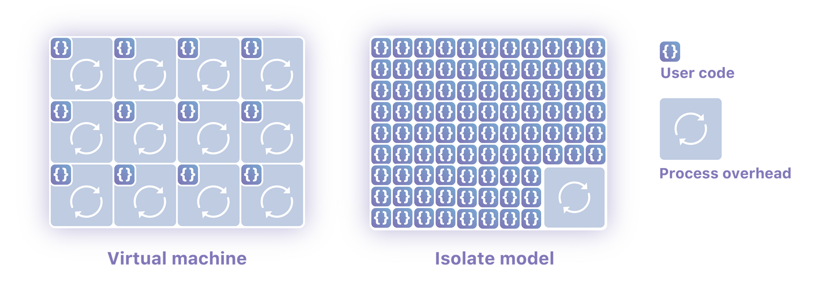
WASM Beyond the Browser A lightweight Server(less) Container
Containers are convenient for cloud application developers
However containers are often not a cost efficient solution
Requires significant CPU, memory, storage and network resources
WASM provides a lightweight sandbox that supports scalable concurrent execution of functions

Slide 5
WASM At Intel WebAssembly Micro Runtime (WAMR)
Bytecode Alliance open source WASM runtime (Intel-led development)
Supports all three modes of execution:
Interpreted byte code
Just-in-Time (JIT) compilation
Ahead of Time (AoT) compilation
Focused on devices: small footprint and memory consumption
Application framework and remote application management
CPU support:
X86-64, X86-32
ARM, THUMB
MIPS
XTENSA
Operating System support:
Linux
Zephyr
AliOS Things
Vxworks
MacOS
Android
SGX (Linux)
https://github.com/bytecodealliance/wasm-micro-runtime

Slide 6
WASM as the Narrow Waist (For Confidential Computing)
language-independent applications
Java
Python
Node
Rust
C/C++
Separate application diversity from physical execution environment → Independent innovation at both layers
WASM
[ + TEE]
bi-directional sandbox
intra-process memory isolation
HW assistance
lightweight context switching
Notes:
Moving towards language-based isolation for scalability, we risk developing a language-specific solution. To avoid that, we choose a lower-level language runtime like WASM that many languages support nowadays. WASM by design isolates memory within a single process, but we see an opportunity to improve the performance and security of this type of isolation with hardware mechanisms.

Slide 7
Example: Smart Contracts for Intel SGX Wawaka Interpreter For Private Data Objects
Enclave
Contract Byte Code
Contract Metadata
Persistent State Handle
Invocation Request (JSON RPC)
Contract Byte Code
Contract Loader
WASM Interpreter
Transaction Metadata
Invocation Result
Crypto Extensions
Persistent State Extensions
Byte code – provided by the contract writer
WASM interpreter – provided by WAMR
Loader and Extensions – provided by PDO

Slide 8
SUPPORT FOR (PROTECTED) DYNAMIC LOADING OF NATIVE CODE AOT Compiled WASM
Contract Native Code
Code Compilation Report
Contract Metadata
Persistent State Handle
Invocation Request (JSON RPC)
Contract Native Code
Contract Loader
WASM Native Call Handler
Transaction Metadata
Invocation Result
Crypto Extensions
Persistent State Extensions
(Almost) Native Code Performance
No Runtime-Compilation Overhead
Application-level Attestation
Native code – provided by the contract writer
Code Compilation Report – provided by compiler enclave
Loader and Extensions – provided by PDO

Slide 9
Labs Project: Code Deployment Integrity (CDI) Contract Compilation in an Enclave
Trusted Compiler Enclaves
Contract Owner
WASM Compiler Enclave
Wawaka Contract Interpreter
WASM Bytecode
Native Code Compilation Report Enclave Signature
Notes:
Common use case

Slide 10
SUmmary
WASM can provide a narrow waist for confidential compute
Language independent virtual machine allows application diversity
Hardware independent virtual machine allows HW-specific capabilities and optimizations
WASM can provide a “protected” method for dynamically loading native code into an enclave
Performant—native code execution
Low Latency—reduced startup time since compilation happens one time, pre-load
PDO Source: https://github.com/hyperledger-labs/private-data-objects

